Slide 1
LIFESTYLE ASSESSMENT: BENEFITS FOR BUSINESSES

Slide 2
FIRSTBEAT
Established in 2002 as a spin-off from Research Institute for Olympic Sports and University of Jyväskylä, Finland
Based on 20 years of research and experience in heartbeat and heart rate variability
Firstbeat has created a unique digital model of the physiology that turns heartbeat data into personal feedback
We bring near laboratory accuracy and technology used by professional athletes to everyone
MANAGE STRESS
ENHANCE RECOVERY
EXERCISE RIGHT

Slide 3
PERSONALIZED INSIGHTS FOR HEALTH AND PERFORMANCE
Professional Sports
More than 22 000 professional athletes and 1000 teams worldwide use Firstbeat solutions to improve performance.
Consumer Products
Firstbeat’s heartbeat analytics are integrated into over 100 wearables to provide meaningful insights for fitness and lifestyle.
Wellness Services
300 000 people around the world have undergone the Firstbeat Lifestyle Assessment to improve their personal well-being & performance.

Slide 4
FIRSTBEAT LIFESTYLE ASSESSMENT
Helps you understand the state of your well-being and what to do to improve it.
Manage stress Recognize activities that cause stress
Enhance recovery See how you recover during sleep
Exercise right See the effect of your exercise
A comprehensive look at well-being during work, leisure and sleep!

Slide 5
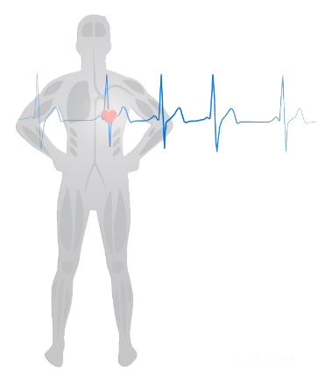
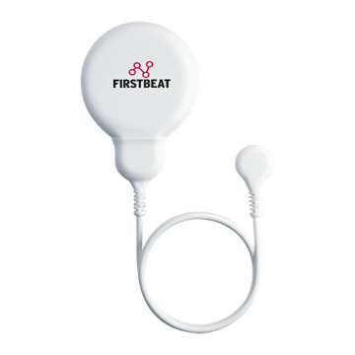
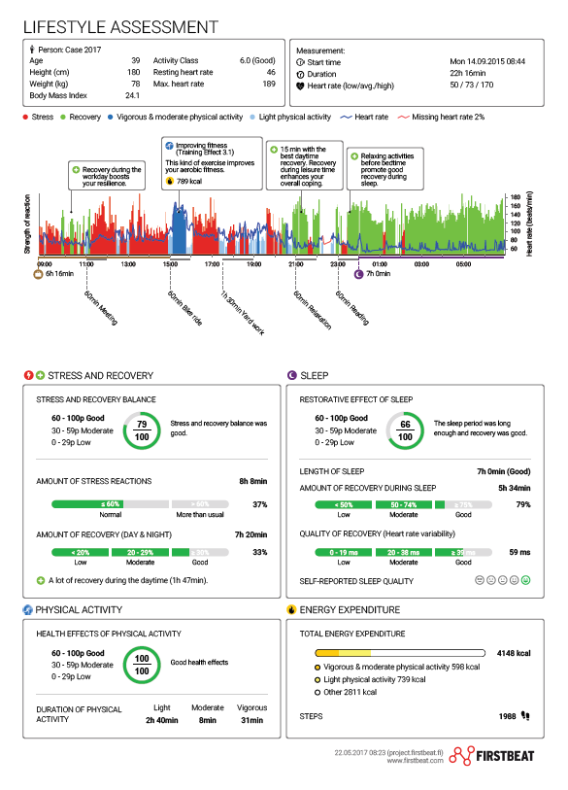
LIFESTYLE ASSESSMENT BACKGROUND
Stress reactions
Recovery
...
Oxygen consumption
Relaxation
Heart rate variability (HRV) contains information about key physiological functions
Firstbeat measures heart rate variability to analyze these functions
Firstbeat produces a comprehensive report about personal well-being

Slide 6
WHAT DOES THE LIFESTYLE ASSESSMENT OFFER TO YOUR BUSINESS?
Data on Well-Being and Performance:
Advice for developing personal well-being and performance (personal report for each employee)
Overview of the well-being of your organization (anonymous group report)
See how to direct employee wellness investments
Ensure the well-being of possible risk groups
Reduce sick leave expenses and risk of early retirement
Control health care costs
A new, exciting method for employee wellness and performance programs
Healthy employees are able to perform at their optimal level

Slide 7
WHO IS LIFESTYLE ASSESSMENT SUITABLE FOR?
Key personnel and executive teams
Wellness programs for entire personnel
Annual health checks, for example
People who travel a lot
Shift workers
As part of targeted wellness initiatives
Stress management
Weight loss
Exercise

Slide 8
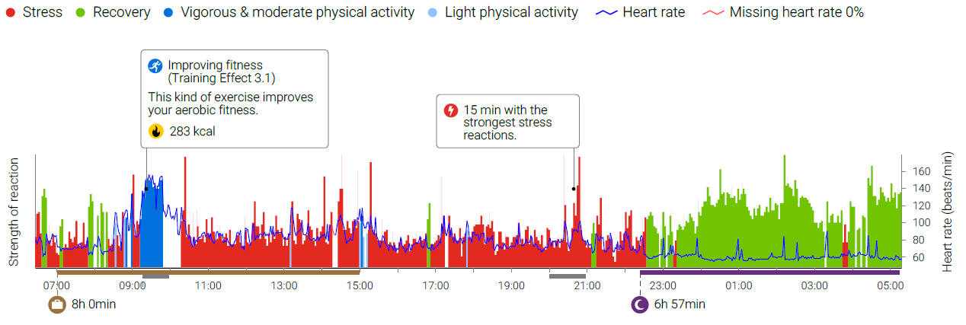
WHAT DOES YOUR DAY LOOK LIKE?
Do you recover during the day?
(e.g. break / relaxation moment)
What are the health and fitness effects of your exercise?
Is your sleep restorative?

Slide 9
LIFESTYLE ASSESSMENT STEPS

Slide 10
GETTING RESULTS
ASSESSMENT
LIFESTYLE CHANGES
IMPACT
3 day assessment during work and leisure
Employees will set a goal of 3 lifestyle changes
85 % feel they are more efficient during the work day
96 % would recommend the Lifestyle Assessment to others
82 % are successful in making lifestyle changes
88 % say the feel better
Managing personnel risks: 3-7% are encouraged to get a health check
Healthcare costs decrease as much as 25%-60%
More efficient employees and better results

Slide 11
CUSTOMER REFERENCES
“In general, we’re moving from the management of chronic diseases to what makes people thrive in all aspects of their life, and that’s the area we try and focus on with Firstbeat technology.”
“We use Firstbeat Lifestyle
Assessment in our coaching
as the benchmark for change
as well as the proof point at
the close”
“The most significant aspect of the program has been the health implications and the impact of stress in the working environment.”
Jason Murray,
Chief Operations Officer,
KPMG Performance Clinic
Duncan Young, Head of Workplace Health and Well-being, Lendlease
Carla Bathauer, Manager, BMW Finance

Slide 12
GOALS THAT PEOPLE TYPICALLY SET TO IMPROVE WELL-BEING
Identify personal stress factors & learn better stress management
Make time for even short recovery moments
Find an enjoyable physical activity
Increase the amount of sleep (34%)
Reduce use of alcohol and stimulants
Source: Firstbeat database, app. 100 000 measurements

